Slide 1
Advertisement Classification
PROMO PRO’S
Team No: College Name: Panimalar Engineering College

Slide 2
Team members Name | Mail id | Team faculty mentors | Mail id
Libeya Mary S | slmary2004@gmail .com | Mrs. Prabha | prabhaitpec@gmail.com
Pavithra R | pavithuraj18@gmail .com | Mrs. Prabha | prabhaitpec@gmail.com
Prithiksha S R | prithiksha474@gmail .com | Mrs. Prabha | prabhaitpec@gmail.com
Reshma R | Reshmarameshbabu 16@gmail.com | Mrs. Prabha | prabhaitpec@gmail.com
Team details
Team Name – Promo Pro’s Team No - College Name - Panimalar Engineering College

Slide 3
PROBLEM STATEMENT
Media houses encounter a significant challenge in assessing the effectiveness of integrated advertising campaigns that span multiple channels, including print, radio, linear video, and OTT platforms. The core issue is the need to verify and demonstrate to advertisers that their ads were indeed delivered and appeared as planned across these diverse formats. Addressing this requires sophisticated image recognition and video analytics to accurately classify and analyse content, identify product and brand names, and seamlessly update core data. The solution should enable the generation of detailed and reliable reports that provide clear insights into campaign performance, thereby ensuring accountability and enhancing the value of media placements for advertisers.

Slide 4
What is the goal you are trying to achieve ?
The system aims to enhance media companies ability to monitor and evaluate integrated advertising campaigns across various channels.
The system will use advanced image recognition and video analytics to accurately identify and analyze ad content, record product and brand names in advertisements, and create comprehensive, analytical reports on campaign effectiveness.
This will increase ad delivery tracking accuracy, campaign effectiveness measurement, and foster transparency and trust between media outlets and their advertising customers. The system will also facilitate actionable feedback to advertisers.

Slide 5
How can you break the problem into specific tasks and what challenges do you anticipate needing to overcome ?
Data collection and integration requires acquiring media content from print, radio, TV, and OTT platforms.
Image and Video Analysis detects and classifies commercials using OCR and video recognition, due to variable ad display and real-time analysis.
Data Correlation and Enrichment links identified advertising to campaign schedules and enriches the data, resolving alignment issues and disparities.
Reporting and Analytics creates performance reports and insights, addressing the problem of effectively presenting complicated data.
Feedback Loop and Optimisation refines campaigns using insights by properly incorporating input and adapting to new media types.

Slide 6
SOLUTION
How are the metrics identified in the problem going to be impacted with the solution?
Ad Delivery Verification
Automated recognition of ad content will improve accuracy in confirming ad delivery across multiple channels (print, radio, TV, OTT). This reduces human error and provides real-time, reliable verification.
Audience Reach & Frequency
By tracking the appearance of ads across platforms, the solution will provide accurate data on how many unique users were exposed to the ads and how often. This helps measure overall reach and frequency.
Cross-Channel Consistency
By identifying ads across channels, the system ensures that the same creative and messaging are deployed uniformly. This will help measure consistency in branding and messaging.
Ad Content Analysis
Image recognition and video analytics will identify products, logos, and brands in the ads, ensuring that the correct content is being delivered. This ensures the right message reaches the audience.
Campaign Effectiveness
The solution enables deeper insights into how each channel contributes to overall campaign performance, helping to optimize media buying decisions and creative choices

Slide 7
What Technology stack would you pick?
1. Data Ingestion Platforms: For collecting ads from various channels (print, radio, linear TV, OTT, etc.).
Tools: Apache Kafka, Amazon Kinesis, or Google Cloud Pub/Sub (for real-time data streaming).
2. Image Recognition & Video Analytics: To process images and videos, recognize content, and extract metadata (brand logos, products, text)
Frameworks: OpenCV, TensorFlow, PyTorch, or Keras.
Pre-trained Models: Google Vision API, Amazon Recognition, or Microsoft Azure Cognitive Services for image/video recognition.
3. ETL (Extract , Transform , Load) Pipelines: For managing data flows from raw media ingestion to analytics-ready formats.
Tools: Apache Nifi, Airflow, or Apache Spark for large-scale processing.
4. Data Transformation: Converting raw image, video, and audio data into usable insights (brand, product names, etc.).
Tools: PySpark, Databricks, or AWS Glue for distributed data processing.
5. Monitoring and Alerts: Ensuring system performance and uptime, tracking model performance in real time.
Tools: Prometheus, Grafana, Datadog, or ELK Stack (Elasticsearch, Logstash, Kibana).

Slide 8
What are the Limitations?
1. Complexity in Handling Multi-Channel Data:
Integrating data from diverse media sources (print, radio, linear TV, OTT) can be complex due to varying formats and standards.
Processing data from channels like radio (audio-only) or print (image-based) can require different tools and methods.
2. Accuracy of Recognition Models:
Image recognition and video analytics systems may struggle with accurately identifying ads, products, logo’s and brands 3. Localization and Language Challenges:
Language variations (e.g., accents, dialects) and localization (e.g., cultural nuances in ads) can create difficulties in accurately classifying ads across different regions.

Slide 9
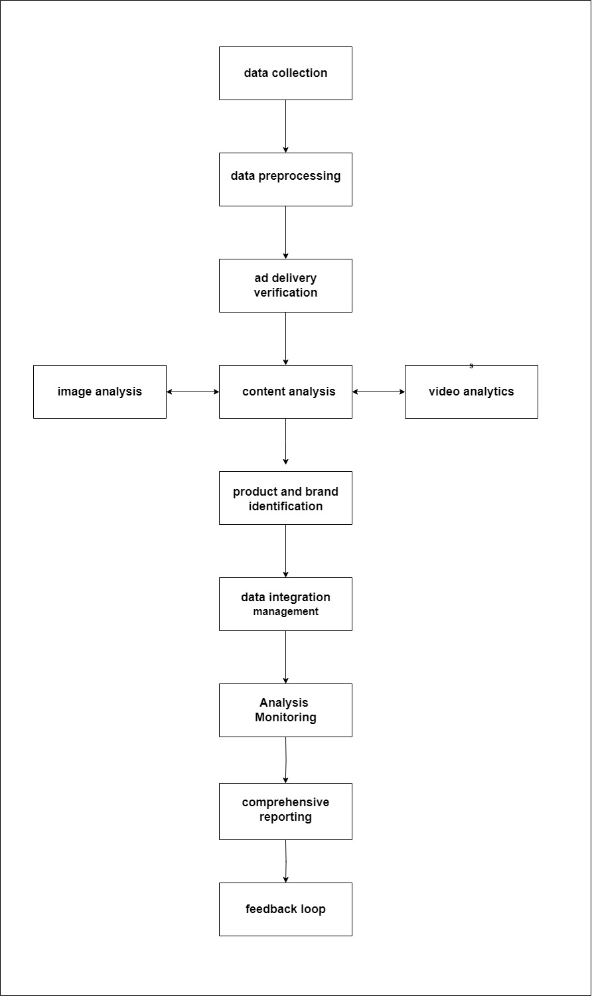
FLOW
CHART

Slide 10
Two Important phases
Classifying Ad to produce brand name, products as output using Ad image as an input
Demonstrate to advertisers that their ads were delivered across these diverse formats

Slide 11
Source Code to Classify Ad using Image Recognition

Slide 12
import torch
import cv2
import pytesseract
import matplotlib.pyplot as plt
# Load the pre-trained YOLOv5 model from Ultralytics
model = torch.hub.load('ultralytics/yolov5', 'yolov5s') # 'yolov5s' for a smaller, faster model
# Function to detect objects (products) in the ad image
def detect_objects(image_path):
results = model(image_path)
detected_objects = results.pandas().xyxy[0] # Extract bounding box, class, confidence
return detected_objects
def extract_text(image_path):
img = cv2.imread(image_path)
gray_img = cv2.cvtColor(img, cv2.COLOR_BGR2GRAY)
text = pytesseract.image_to_string(gray_img)
return text
# Function to classify ad and extract brand names and products
def classify_ad(image_path):
print("Processing Ad Image: ", image_path)
detected_objects = detect_objects(image_path)
print("Detected Products:")
print(detected_objects[['name', 'confidence']])
extracted_text = extract_text(image_path)
print("\nExtracted Text (Potential Brand/Product Names):")
print(extracted_text)
plt.imshow(cv2.cvtColor(cv2.imread(image_path), cv2.COLOR_BGR2RGB))
plt.title("Ad Image with Detected Products")
plt.show()
image_path = 'path_to_ad_image.jpg' # Replace with the path to your ad image
classify_ad(image_path)

Slide 13
Source Code to Demonstrate that ads were delivered across the diverse channels

Slide 14
from PIL import Image
import imagehash
# Function to compute the hash of an image
def compute_image_hash(image_path):
img = Image.open(image_path)
img_hash = imagehash.phash(img) # Perceptual Hashing (pHash)
return img_hash
# Function to compare the original ad with the publisher's version
def verify_ad_delivery(original_ad_path, publisher_ad_path, threshold=5):
original_ad_hash = compute_image_hash(original_ad_path)
publisher_ad_hash = compute_image_hash(publisher_ad_path)
hash_difference = original_ad_hash - publisher_ad_hash
print(f"Hamming distance between original and publisher ad: {hash_difference}")
if hash_difference <= threshold:
print("The ad has likely reached the publisher.")
return True
else:
print("The ad did not reach the publisher or has been significantly altered.")
return False
original_ad_path = 'path_to_original_ad.jpg'
publisher_ad_path = 'path_to_publisher_ad.jpg'
verify_ad_delivery(original_ad_path, publisher_ad_path)

Slide 15
Architecture Diagram

Slide 16
User Interface

Slide 17
Mentor connect details (Kindly add the details of the connect had with the mentors)
Date of connect | Time | Details on the development | Agenda of the meet
DD-MM-YY | HH:MM |  | Meeting agenda on the topic

Slide 18
Additional Information <Any relevant attachment>
Link here
18

Slide 23
Thank you

